Slide 1
Compton Scattering
Alejandro Legarda

Slide 2
Purpose
To show how the energy of Compton-scattered photons depends on the angle of scattering. Specifically, we tested the validity of the Compton equation for Cs-137 and using an aluminum scatterer.

Slide 3
Method
Our setup consists of a pair of radioactive Caesium-137 sources housed in a radio-insulating box with a narrow opening.
These produce gamma rays at 662 keV, which come out the opening as a collimated beam. The radioactive decay is
directed at a cylindrical aluminum rod that scatters incoming photons at random angles.

Slide 4
A photomultiplier tube is mounted on a circular rail, allowing us to observe photons at different scattering angles. Photon energy is quantified using software, allowing us to record the relationship between scattering angle and photon energy.

Slide 5
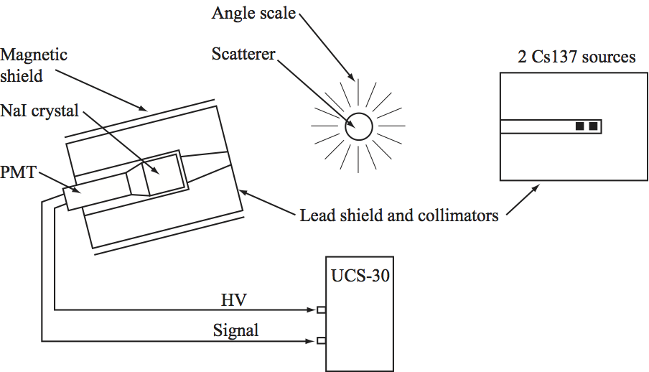
Apparatus

Slide 6
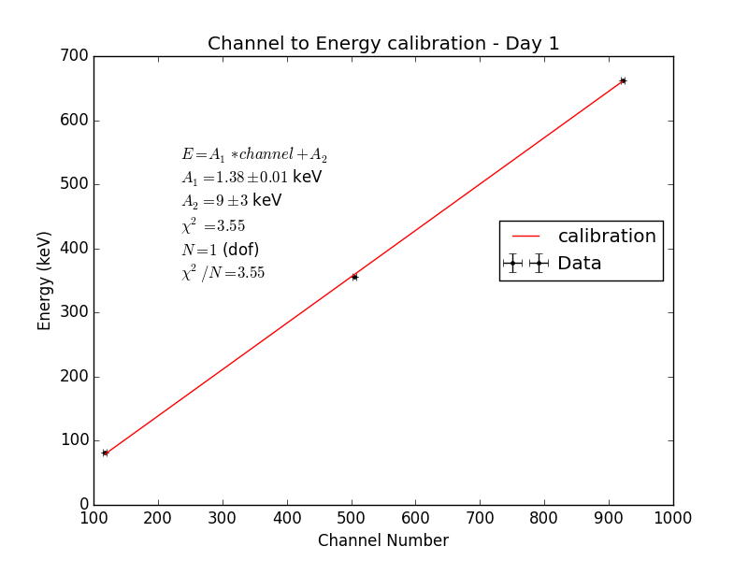

Slide 7
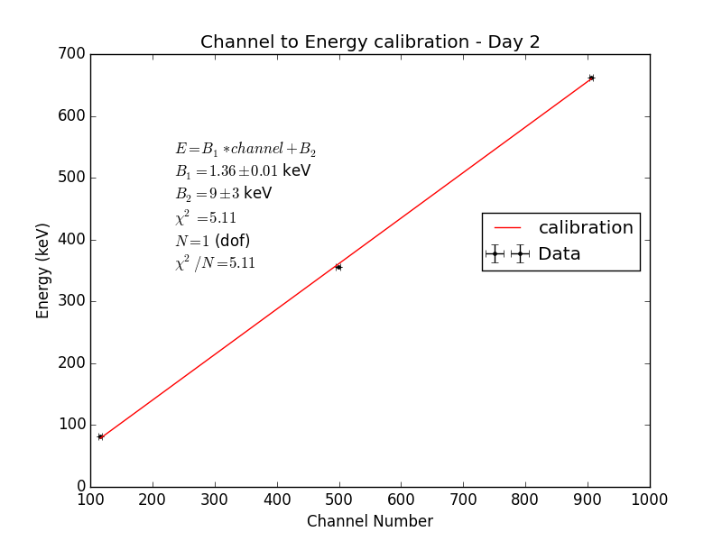

Slide 8
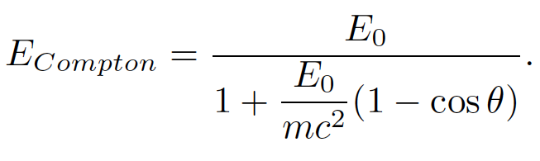

Slide 9
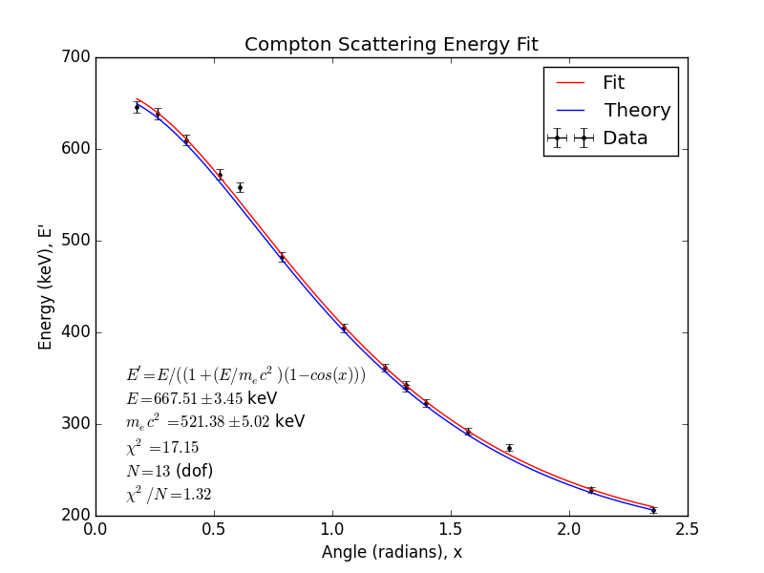

Slide 10
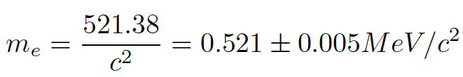

Conclusion
This is close, but not in great agreement with the literature value given below.

Slide 11
We conclude that our data and fits show the Compton relation well. Our biggest issue seems to be the systematic lower-than-actual energy measurements, as can be seen in our final plot. This could be simply due to energy loss somewhere in the apparatus before the quantification of photon energy is done. Overall, our data agrees well with the expected relationship from the Compton scattering formula, but is not useful for extracting fine constants such as the electron rest mass.

